Slide 1
Recurrent Neural Network (RNN)
■ Traditional Neural networks don’t have memory to retain past inputs
■ However human brain has persistence
o Previous video frames helps better understand the current video frame
o Previous words helps better understand the current word
o Previous week sales better explains current week sales
■ RNN tries to achieve persistence using hidden states
Vanishing Gradient Problem
■ RNN has a short term memory problem
■ Sometimes we don’t need our network to learn only from immediate past information
■ There is a gap between the information what we want to predict and from where we want it to get predicted
■ During the training of RNN, as the information goes in loop again and again which results in very large updates to neural network model weights.
■ This is due to the accumulation
of error gradients during an update and hence, results in an unstable network.

Slide 2
Long Short Term Memory (LSTM)
■ An LSTM is a special kind of RNN architecture, capable of learning long-term dependencies.
■ LSTM uses gates to control the memorizing process
■ Tanh: Derivative can sustain for a long range
■ Sigmoid: As Sigmoid can output 0 or 1, it can be used to forget or remember the information.
■ LSTM networks generally outperform RNNs
■ Can be used for Text Analytics, Time Series Forecasting etc.

Slide 3
LSTM has 3 gates
4.2.1 Gate 1: What to Forget?
■ This sigmoid layer is called the “forget gate layer.”
■ It looks at h(t−1) and x(t), and outputs a number between 0 and 1
■ The closer to 0 means to forget, and the closer to 1 means to keep.
■ If the context has changed from one to another, previous context will be forgotten
4.2.2 Gate 2: What new information to store?
■ tanh function to squish values between -1 and 1 to help regulate the network
■ This sigmoid layer called the “input gate layer” decides which values we’ll update. Values will be between 0 and 1. 0 means not important, and 1 means important
■ sigmoid output will decide which information is important to keep from the tanh output
4.2.3 Gate 3: Output Gate
■ Decides what the next hidden state should be
■ previous hidden state and the current input is passed into a sigmoid function
■ sigmoid layer decides what parts of the cell state we’re going to output
■ cell state is put through tanh (to push the values to be between −1 and 1) and multiply it by the output of the sigmoid gate

Slide 4
Keras Modeling Process
Define
DNN
CNN
RNN
Compile
Optimizer
Loss
Metrics
Fit
Batch Size
Epochs
Data Splits
Predict
Number
Classes
Probability

Slide 5
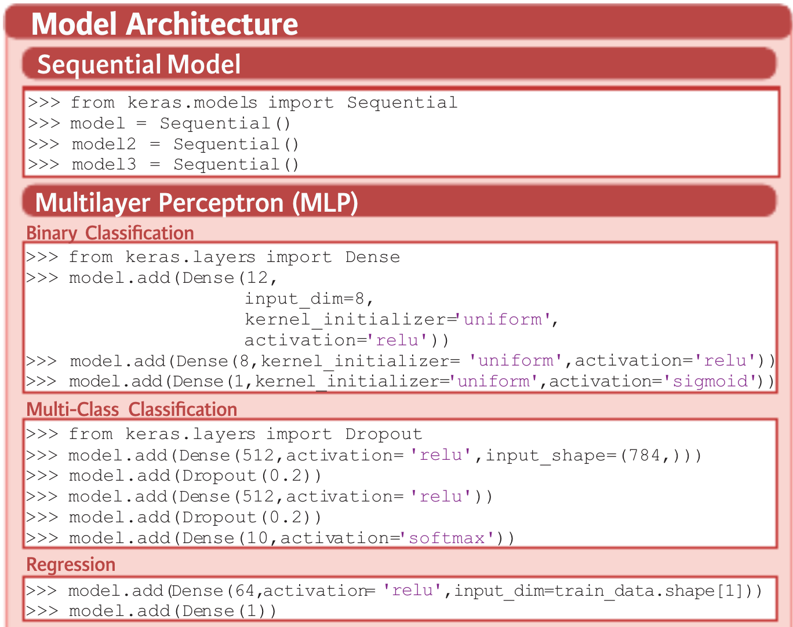

Slide 6
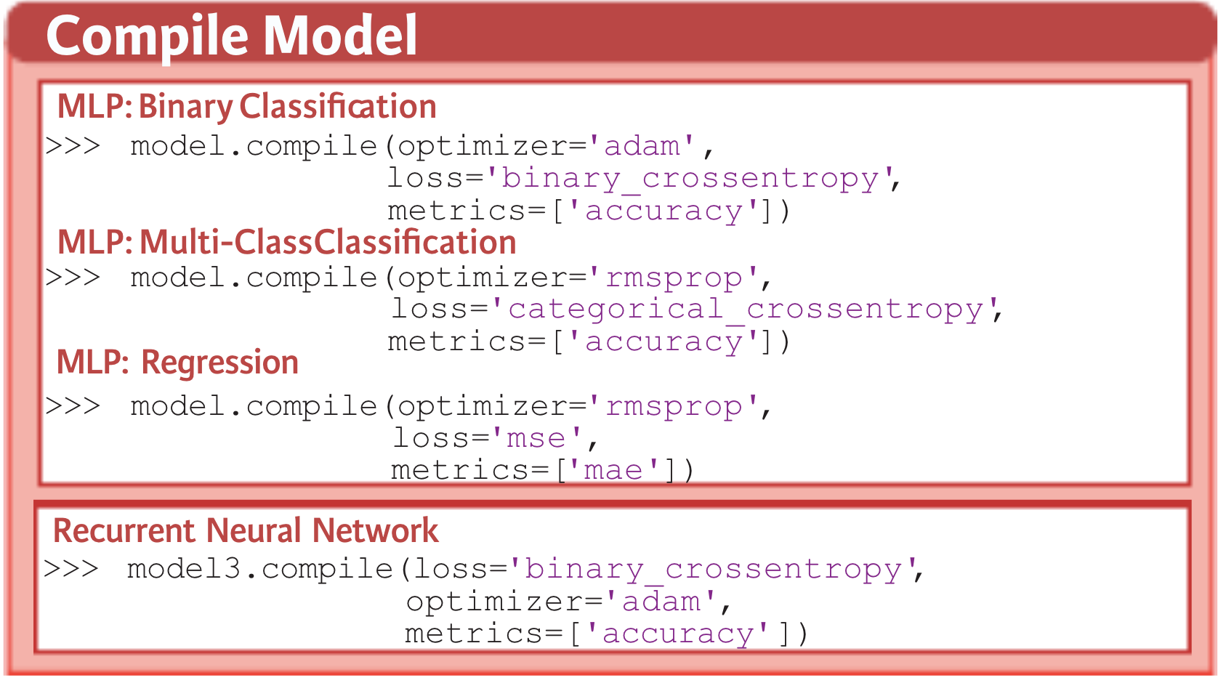

Slide 7
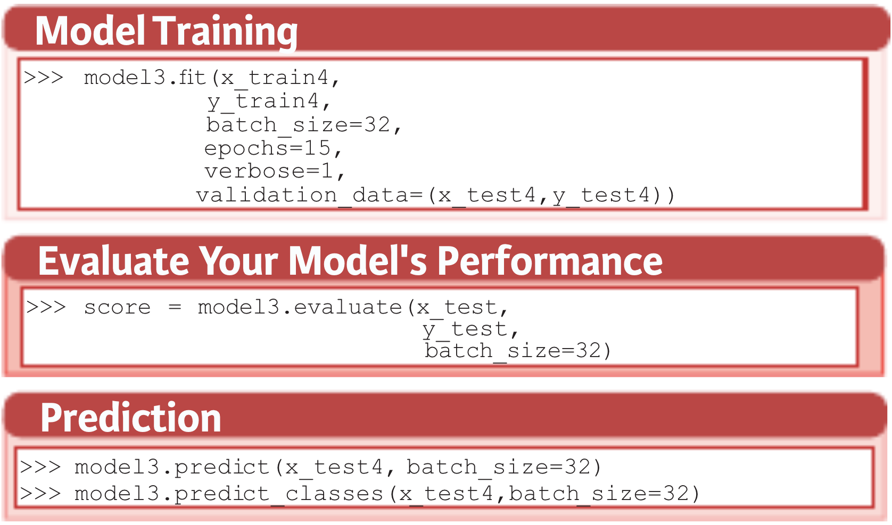

Slide 8
